Slide 1

Accessing Databases using Python

Slide 2
Objectives
Access databases from Python using SQL magic.
Describe concepts related to accessing Databases using Python.
Create tables and insert data using Python.
Connect to a database using ibm_db Python library.
Accessing Databases using Python

Slide 3
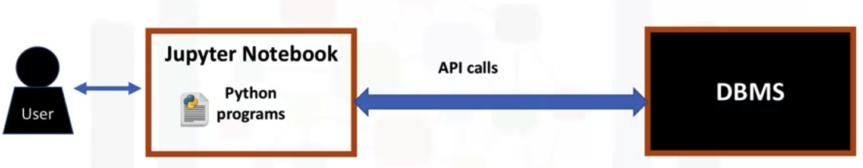
Access Databases Using Python
What are Jupyter Notebooks? The Jupyter notebook is an open source web application that allows you to create and share documents that contain live code, equations, visualizations, and narrative texts.
Accessing Databases using Python

Slide 4
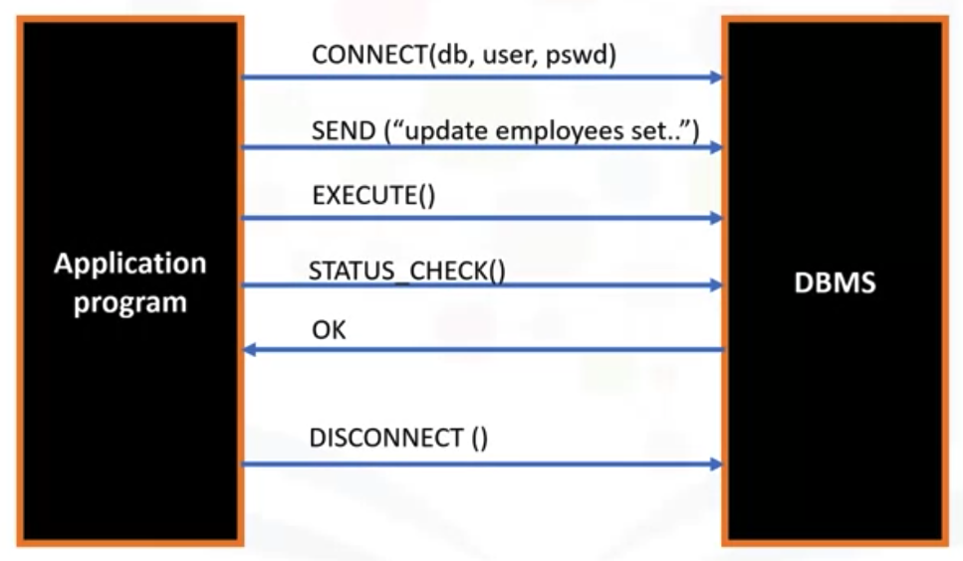
Access Databases Using Python
SQL API
Accessing Databases using Python

Slide 5
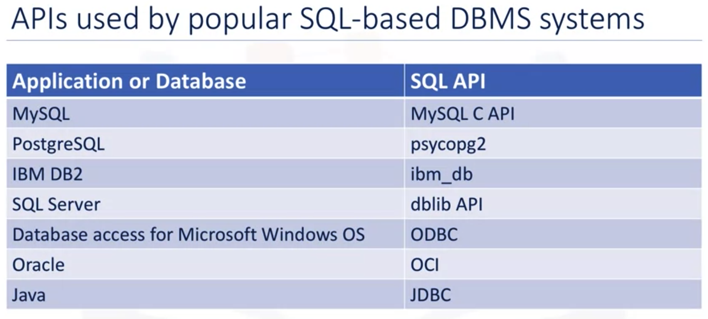
Access Databases Using Python
Accessing Databases using Python

Slide 6
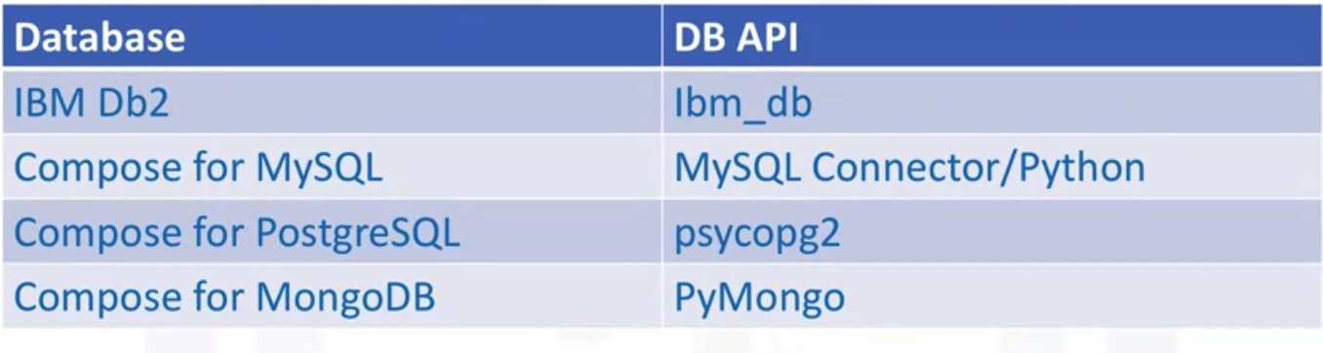
Using DB-API
Example of libraries
Accessing Databases using Python

Slide 7
Concepts of the Python DB API
Connection Object
  Database connections
  Manage transactions
Cursor Objects
  Database queries
  Scroll through result set
  Retrieve results
Accessing Databases using Python

Slide 8
Using DB-API
These connection methods are:
  The cursor() method, which returns a new cursor object using the connection.
  The commit() method, which is used to commit any pending transaction to the database.
  The rollback() method, which causes the database to roll back to the start of any pending transaction.
  The close() method, which is used to close a database connection.
Accessing Databases using Python

Slide 9
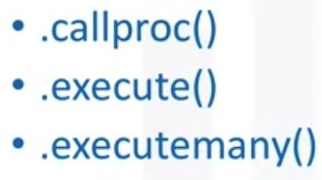


Using DB-API
The cursor methods :
  These objects represent a database cursor, which is used to manage the content of a fetch operation.
  Cursors created from the same connection are not isolated that is, any changes done to the database by a cursor are immediately visible by the other cursors.
  Cursors created from different connections can or cannot be isolated depending on how the transaction support is implemented.
Accessing Databases using Python

Slide 10
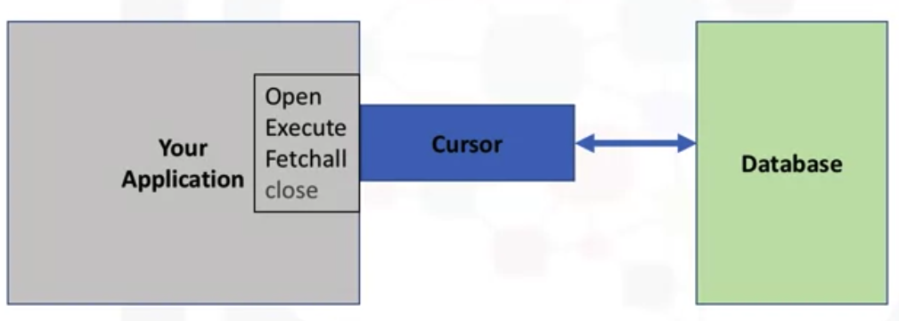
Using DB-API
What is a database cursor:
Accessing Databases using Python

Slide 11
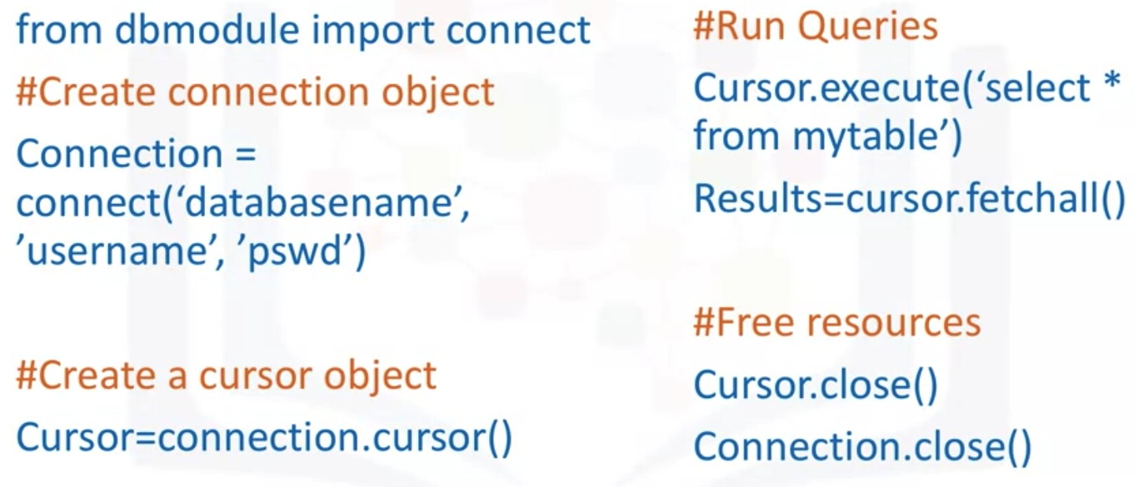
Writing code using DB-API
Accessing Databases using Python

Slide 12
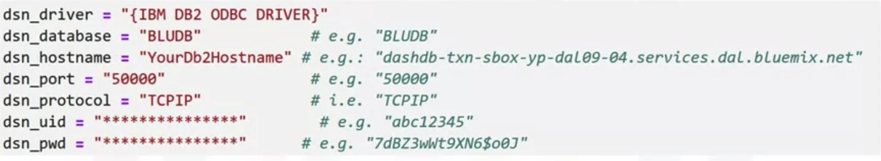
Connect to DB using ibm_db API
What is ibm_db?
  The ibm_db API provides a variety of useful Python functions dor accessing and manipulating data in an IBM data server Database
  Ibm_db API uses the IBM Data Server Driver for ODBC and CLI APIs to connect to IBM DB2 and informix
Identify database connection credentials
Accessing Databases using Python

Slide 13
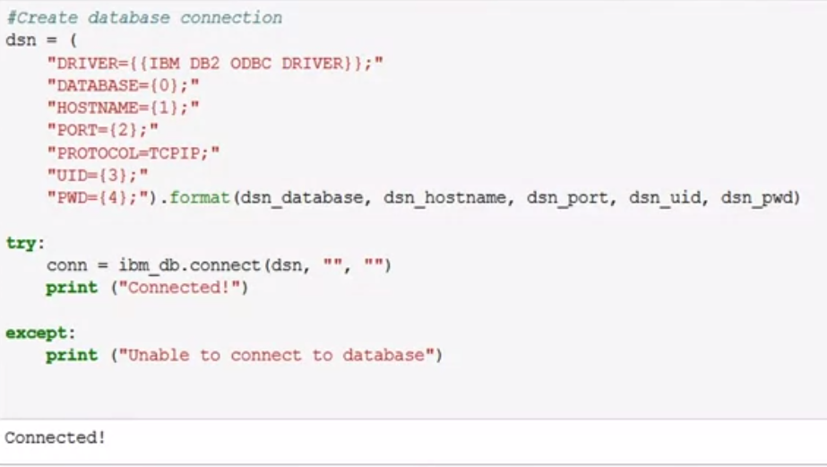

Create a database connection
Accessing Databases using Python

Slide 14

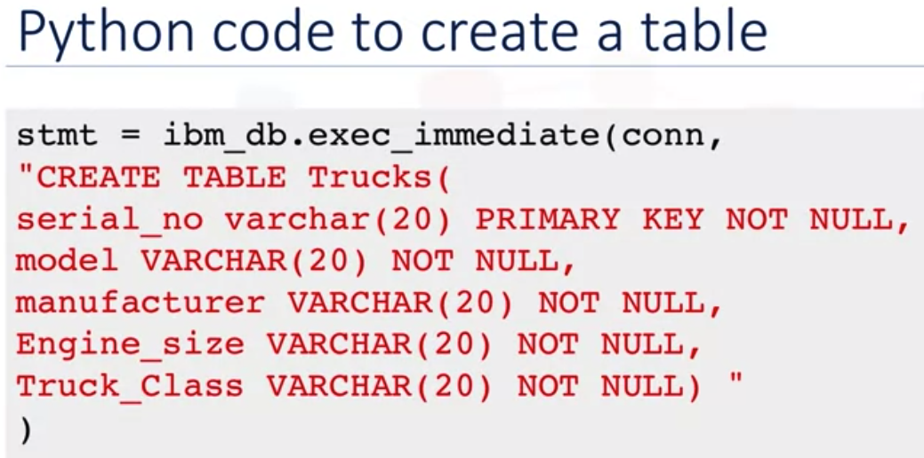
Create table, loading data, query
Accessing Databases using Python

Slide 15
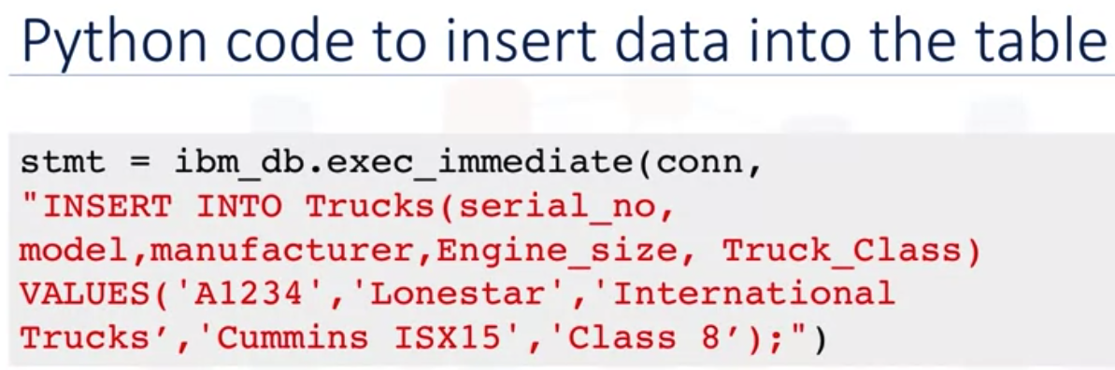
Create table, loading data, query
Accessing Databases using Python

Slide 16
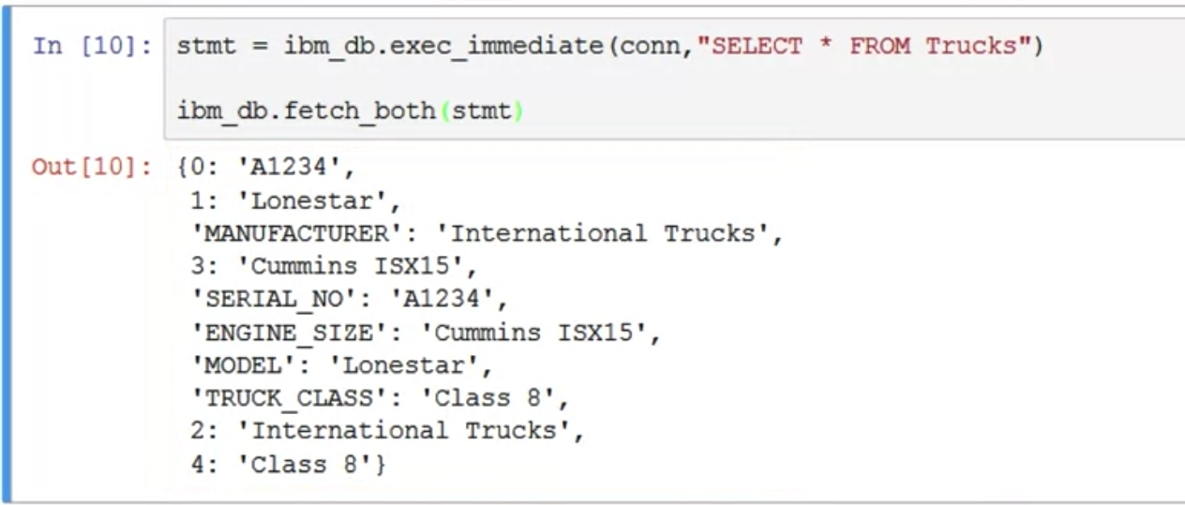
Create table, loading data, query
Python code to query data
Accessing Databases using Python

Slide 17
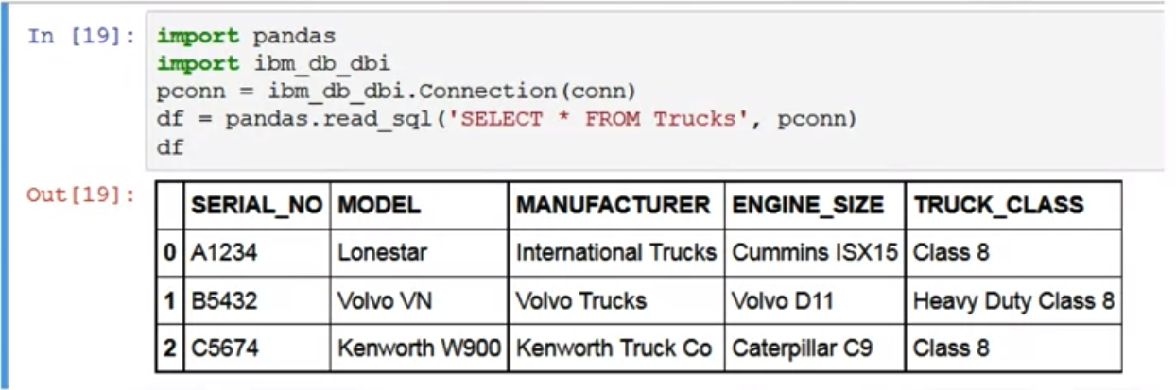
Create table, loading data, query
Python code to query data using pandas
Accessing Databases using Python

Slide 18
Summary
Access databases from Python using SQL magic.
Describe concepts related to accessing Databases using Python.
Create tables and insert data using Python.
Connect to a database using ibm_db Python library.
Accessing Databases using Python

Slide 19
Q & A
Accessing Databases using Python

